Slide 1
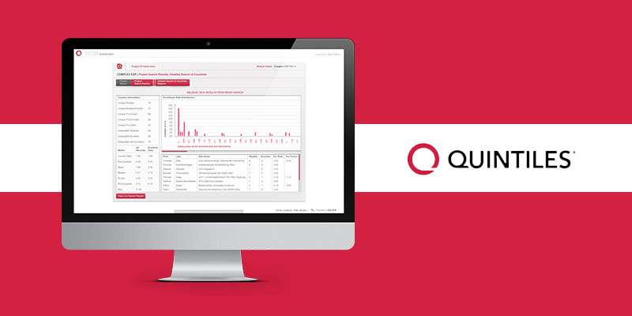

Quintiles Dashboard
The Challenge
Quintiles, an industry leading Contract Research Organization (CRO), approached Affirma with a set of unique challenges. Multiple business units had approached their IT innovations department with concerns that their current tools were unable to keep up with their large-scale data processing demands. Quintiles asked the Affirma team to discern critical areas for improvement and to implement the changes needed. Affirma identified several core challenges: integrating data contained in disparate locations, enhancing data processing speed and scalability, and optimizing their predictive analytic tools.<
Results
<p>Affirma&rsquo;s custom solution not only increases the scalability of existing tools, it also saves users&rsquo; valuable time, and allows for widespread adoption by leveraging a user-friendly interface. The upgraded platform can support multiple business units simultaneously and will be deployable to 100+ project managers in the field for on-the-ground, real-time support.</p>
What We Did
<ul>
<li>Affirma Designed a package that addresses Quintiles&rsquo; primary pain points utilizing .NET, SQL Server 2012, SharePoint, PowerPivot and PowerView.</li>
<br />
<li>Affirma constructed an umbrella API dashboard to house a multitude of tools.</li>
<br />
<li>Without leaving the simple, intuitive dashboard interface, users can: access different data sources, display powerful visuals, identify the necessary attributes with an array of upgraded tools, and generate results to support high-impact business units.</li>
</ul>

